Slide 1


SMART INDIA HACKATHON 2024
TITLE PAGE
Problem Statement ID – SIH1606
Problem Statement Title- Micro-Doppler Target Classification
Theme-Robotics and Drones
PS Category- Software
Team ID- MECH11
Team Name-Motion Mavericks

Slide 2
MICRO DOPPLER SIGNATURE BASED TARGET CLASSIFICATION
MOTION MAVERICS
Generally, Radar Cross section(RCS) method is used in detecting flying objects, such as planes.
Radar Cross Section (RCS) method has limitations as it primarily measures the size and shape of a target, struggling to differentiate between similar-sized objects and identify specific activities.
Distinguishing drones from birds is challenging with RCS alone, as both can have comparable sizes and shapes.

Slide 3
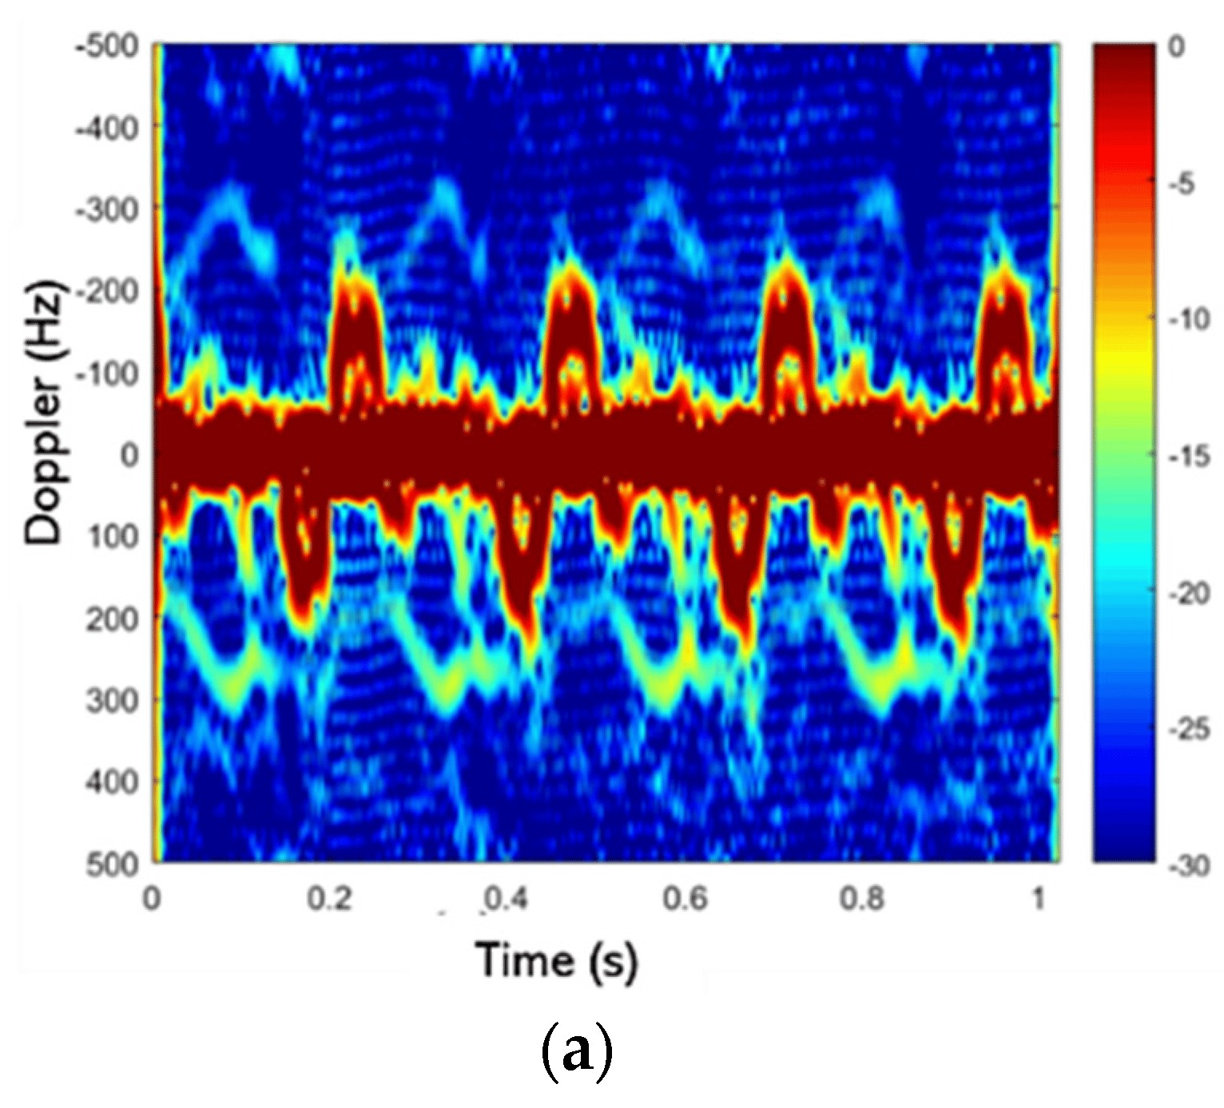
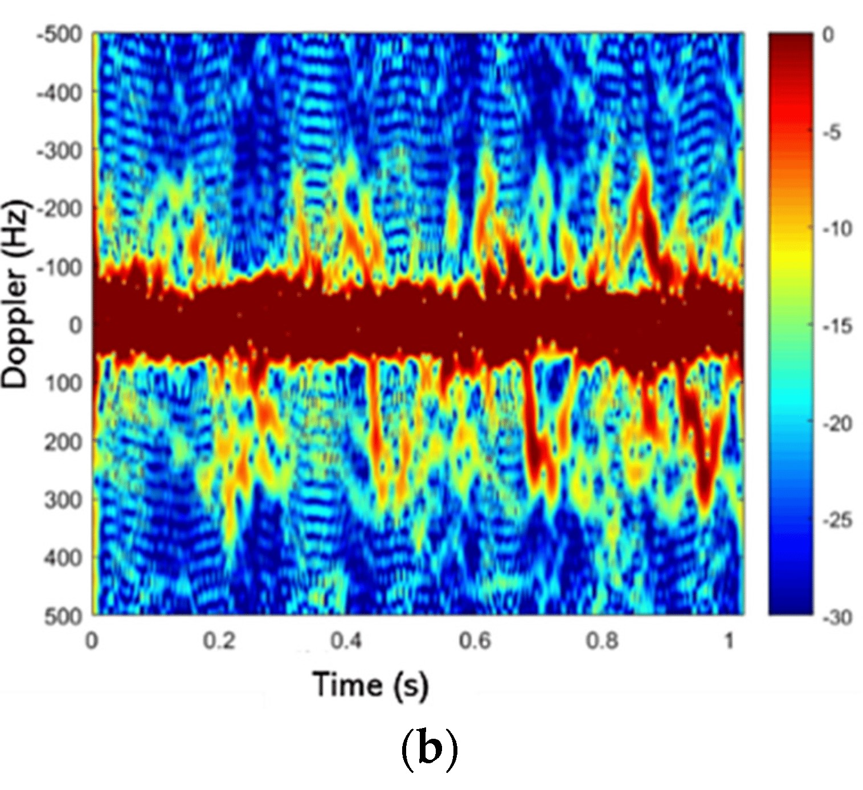

TECHNICAL APPROACH
MOTION MAVERICS
Drone
$$f_{m}=\left[f_{u}\left[\frac{c+v}{c−v}\right]\right]−f_{u}$$
Frequency Value
Radar
Raw Data
Bird

Slide 4
FEASIBILITY AND VIABILITY IMPACT AND BENEFITS
MOTION MAVERICS
The feasibility of Doppler signature analysis is well-established Radar micro-Doppler signatures have been extensively studied for target classification and recognition
Doppler frequency can help in distinguishing between targets and background noise : In environments where targets are moving, Doppler information can provide real-time updates on their status, aiding in accurate classification and tracking
It is used for detecting, tracking, and identifying potential of birds (or) Drones
It helps in finding the type of drones

Slide 5
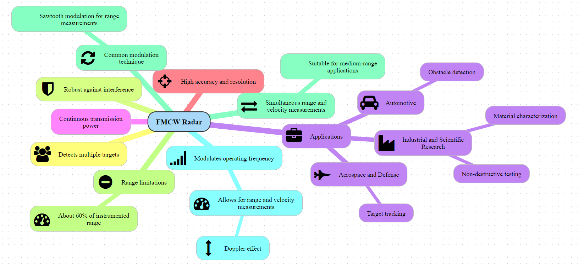

Slide 6

RESEARCH AND REFERENCES
MOTION MAVERICS
Demo video:
Doppler Frequency
https://www.sciencedirect.com/topics/engineering/doppler-frequency-shift
Radar System
https://www.britannica.com/technology/radar/Factors-affecting-radar-performance
Drive link:
https://drive.google.com/drive/folders/1HBkMrQkqLvSatA40OMnSYEuiq6t9_sd2?usp=sharing

